Slide 1
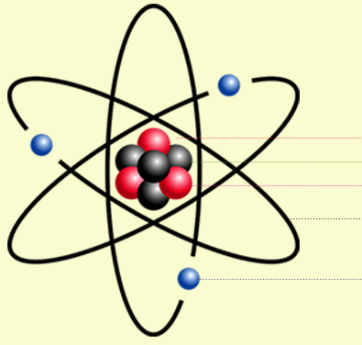
Daily Review
Describing the Structure of an Atom
State the number of protons and neutrons in the nucleus. State the number of electrons orbiting the nucleus. State whether the atom is neutral or charged. neutral = number of protons and electrons is equal charged = number of protons and electrons is not equal
Describe the structure of the beryllium atom.
Proton
There are ___ protons and ___ neutrons in the nucleus.
There are ___ electrons orbiting the nucleus.
The atom is ________ because __________.
Neutron
Electron

Slide 2
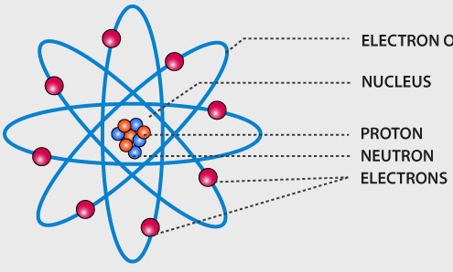
Daily Review
Describing the Structure of an Atom
State the number of protons and neutrons in the nucleus. State the number of electrons orbiting the nucleus. State whether the atom is neutral or charged. neutral = number of protons and electrons is equal charged = number of protons and electrons is not equal
Describe the structure of the beryllium atom.
There are ___ protons and ___ neutrons in the nucleus.
There are ___ electrons orbiting the nucleus.
The atom is ________ because __________.

Slide 3
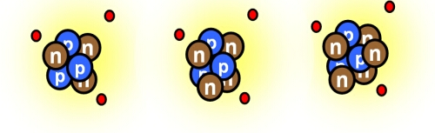
Daily Review
CFU 1
What is the atomic mass of each of these lithium atoms?
Atomic Mass
The mass of an atom is found by adding the number of protons and neutrons.
Different isotopes are written with their atomic mass after the element name, for example helium-4 or helium-5.
CFU 2
Write the name of each lithium isotope.

Slide 4
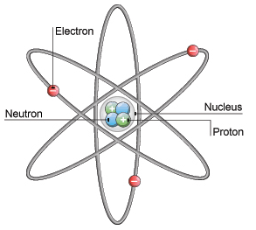
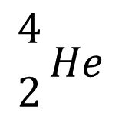
Daily Review
CFU 1
What three things does an atomic symbol include?
Atomic Symbols
An atomic symbol always includes:
The symbol of the element
The atomic number (in front of and below the element symbol)
The atomic mass (in front of and above the element symbol)
This helium atom can be represented as:
CFU 2
How is the atomic mass written?
$${4 \atop 2}He$$
Vocabulary
Subatomic: smaller than, or occurring within, an atom

Slide 5
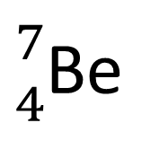
Daily Review
Representing Isotopes as Atomic Symbols
Write the element symbol. Count the number of protons and write the atomic number in front of and below the element symbol. Count the number of protons and neutrons and write the atomic mass in front of and above the element symbol.
Proton
Neutron
Write an atomic symbol for the beryllium isotope.
Electron
${7 \atop 4}$Be

Slide 6
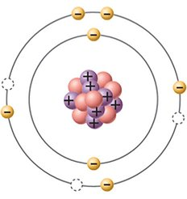
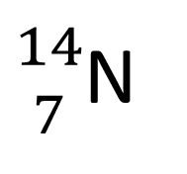
Daily Review
Representing Isotopes as Atomic Symbols
Write the element symbol. Count the number of protons and write the atomic number in front of and below the element symbol. Count the number of protons and neutrons and write the atomic mass in front of and above the element symbol.
Write an atomic symbol for the nitrogen isotope.
${14 \atop 7}$N

Slide 7
Electron Configuration Year 9 Chemistry

Slide 8
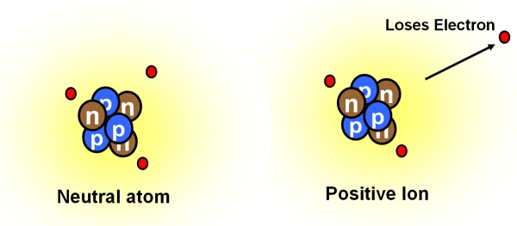
Learning Objectives
CFU
What are we going to learn?
Draw the arrangement of electrons around a nucleus using electron shell diagrams.
Use electron configurations to represent the arrangement of electrons in an atom.
Activate Prior Knowledge
Look at the picture of the two lithium atoms.
Think-pair-share: Which of these would be a charged atom? Explain your choice.

Slide 9
Concept Development
CFU 1
Where would an electron be located?
Structure of Atoms
Atoms are made of three subatomic particles: protons, neutrons and electrons.
Protons and neutrons are found in the centre of an atom, which is called the nucleus.
Electrons orbit the nucleus at very high speeds.
In a neutral atom, the number of protons is equal to the number of electrons.
CFU 2
What charge does an electron have?
CFU 3
Even though electrons are moving very fast, why do they not fly away from the nucleus?
Vocabulary
Subatomic: smaller than, or occurring within, an atom

Slide 10
Concept Development
CFU 1
What are the areas electrons occupy called?
Electron Shells
Electrons do not orbit the nucleus randomly, they occupy specific areas of space around the nucleus.
These areas are called electron shells.
Each shell can only hold a limited number of electrons.
The first shell holds up to 2 electrons
The second shell holds up to 8 electrons
The third shell holds up to 18 electrons
The arrangement of electrons in an atom is called its electron configuration.
CFU 2
How many electrons can the third electron shell hold?
CFU 3
In the atom shown, how many more electrons could fit in the second electron shell?
Vocabulary
Subatomic: smaller than, or occurring within, an atom

Slide 11
Concept Development
CFU 1
How do electrons fill the first electron shell?
Electron Shells
Electron shells are filled in a predictable way.
The first 2 electrons go in the first shell, one on each side.
The next 4 electrons go in the second shell, starting at the top and moving clockwise.
The next 4 electrons, go in the second shell and form pairs with the other electrons.
The third shell fills in the same way as the second.
CFU 2
Explain how the second electron shell is filled.
CFU 3
Draw an atom that has 8 electrons in its shells.
Nucleus
Vocabulary
Subatomic: smaller than, or occurring within, an atom

Slide 12
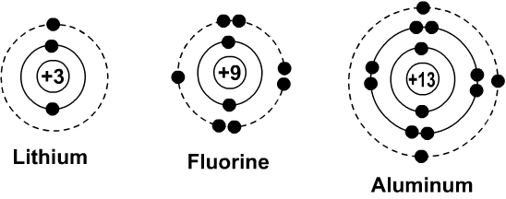
Concept Development
CFU 1
How many electrons are in the valence shell for the three atoms?
Electron Shells
The outermost electron shell is called the valence shell.
The chemical properties of an element are determined by the number of electrons in the valence shell.
Elements with the same number of valence electrons react in similar ways.
CFU 2
What is determined by the number of valence electrons?
Vocabulary
Subatomic: smaller than, or occurring within, an atom

Slide 13
Concept Development
CFU 1
How are electron arrangements shown in number form?
Electron Configuration
The arrangement of electrons in each shell can also be represented using numbers.
The number of electrons in each shell is listed in order from the innermost shell to the outermost shell.
The numbers are separated by commas.
For example, the electrons in the nitrogen atom can be shown as: 2, 5
CFU 2
Write the electron configuration for the lithium, fluorine and aluminium atoms.
Vocabulary
Subatomic: smaller than, or occurring within, an atom

Slide 14
Skill Development/Guided Practice
Reminder:
1st shell holds 2 electrons 2nd shell holds 8 electrons 3rd shell holds 18 electrons
Drawing Electron Shell Diagrams
Identify the number of electrons in the atom (hint: same as the number of protons) Draw a circle to represent the nucleus, including the symbol. Draw the first electron shell, and add electrons until it is full. Draw the second electron shell, and add electrons until it is full. Continue until all electrons are shown. Write the electron configuration underneath.
3 Electrons
Draw an electron shell diagram for lithium.
Li
Electron Configuration: 2, 1

Slide 15
Skill Development/Guided Practice
Reminder:
1st shell holds 2 electrons 2nd shell holds 8 electrons 3rd shell holds 18 electrons
Drawing Electron Shell Diagrams
Identify the number of electrons in the atom (hint: same as the number of protons) Draw a circle to represent the nucleus, including the symbol. Draw the first electron shell, and add electrons until it is full. Draw the second electron shell, and add electrons until it is full. Continue until all electrons are shown. Write the electron configuration underneath.
6 Electrons
Draw an electron shell diagram for carbon.
C
Electron Configuration: 2, 4

Slide 16
Skill Development/Guided Practice
Reminder:
1st shell holds 2 electrons 2nd shell holds 8 electrons 3rd shell holds 18 electrons
Drawing Electron Shell Diagrams
Identify the number of electrons in the atom (hint: same as the number of protons) Draw a circle to represent the nucleus, including the symbol. Draw the first electron shell, and add electrons until it is full. Draw the second electron shell, and add electrons until it is full. Continue until all electrons are shown. Write the electron configuration underneath.
11 Electrons
Draw an electron shell diagram for sodium.
Na
Electron Configuration: 2, 8, 1

Slide 17
Skill Development/Guided Practice
Reminder:
1st shell holds 2 electrons 2nd shell holds 8 electrons 3rd shell holds 18 electrons
Drawing Electron Shell Diagrams
Identify the number of electrons in the atom (hint: same as the number of protons) Draw a circle to represent the nucleus, including the symbol. Draw the first electron shell, and add electrons until it is full. Draw the second electron shell, and add electrons until it is full. Continue until all electrons are shown. Write the electron configuration underneath.
8 Electrons
Draw an electron shell diagram for oxygen.
O
Electron Configuration: 2, 6

Slide 18
Skill Development/Guided Practice
Reminder:
1st shell holds 2 electrons 2nd shell holds 8 electrons 3rd shell holds 18 electrons
Drawing Electron Shell Diagrams
Identify the number of electrons in the atom (hint: same as the number of protons) Draw a circle to represent the nucleus, including the symbol. Draw the first electron shell, and add electrons until it is full. Draw the second electron shell, and add electrons until it is full. Continue until all electrons are shown. Write the electron configuration underneath.
17 Electrons
Draw an electron shell diagram for chlorine.
Cl
Electron Configuration: 2, 8, 7

Slide 19
Skill Development/Guided Practice
Reminder:
1st shell holds 2 electrons 2nd shell holds 8 electrons 3rd shell holds 18 electrons
Drawing Electron Shell Diagrams
Identify the number of electrons in the atom (hint: same as the number of protons) Draw a circle to represent the nucleus, including the symbol. Draw the first electron shell, and add electrons until it is full. Draw the second electron shell, and add electrons until it is full. Continue until all electrons are shown. Write the electron configuration underneath.
13 Electrons
Draw an electron shell diagram for aluminium.
Al
Electron Configuration: 2, 8, 3

Slide 20
Relevance
Knowing about how electrons are arranged in an atom will help you understand how different atoms react together in predictable ways to form compounds.

Slide 21
Skill Closure
Reminder:
1st shell holds 2 electrons 2nd shell holds 8 electrons 3rd shell holds 18 electrons
How are electrons arranged in an atom?
Skill Closure
How many electrons can fit into the:
1st shell?
2nd shell?
3rd shell?
Drawing Electron Shell Diagrams
Identify the number of electrons in the atom (hint: same as the number of protons) Draw a circle to represent the nucleus, including the symbol. Draw the first electron shell, and add electrons until it is full. Draw the second electron shell, and add electrons until it is full. Continue until all electrons are shown. Write the electron configuration underneath.
Skill Closure
Draw an electron shell diagram and write the electron configuration for phosphorus.

Slide 22
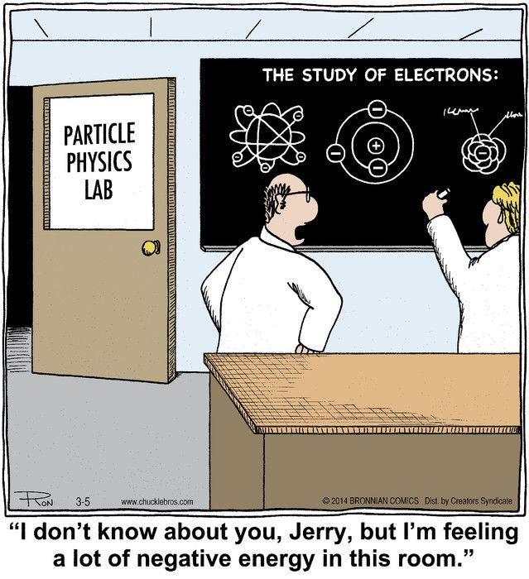
Independent Practice
Complete the “Arranging Electrons” worksheet on your device or on a paper copy.

